Slide 2
Blank subtraction
RT, Intensity, m/z cutoffs
Smearing
Similarity grouping
Standards list removal
Detection frequency
CCS v m/z cutoff
Isotopic grouping
Post source decay
CCS, m/z, RT target match (Likely)
CCS, RT v m/z regression
Adduct removal
m/z target match (Tentative)
Fluorinated suspects (no match)
Algorithms without user tunability
Tunable algorithms based on user input

Slide 3
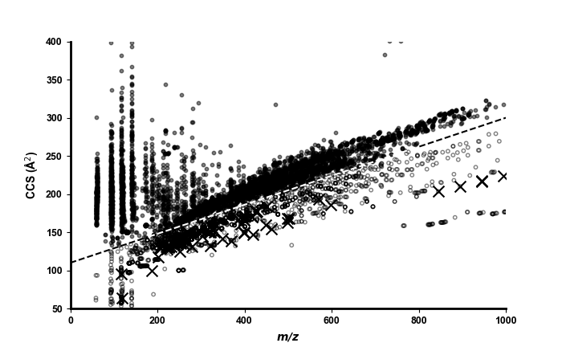
CCS v m/z cutoff
3289 features
1680 features
Point below cutoff
Point above cutoff
PFAS suspect

Slide 4
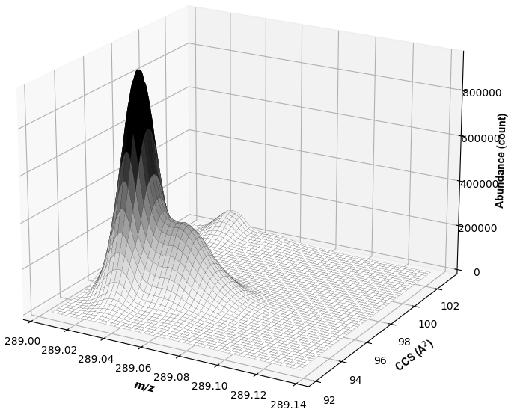

Slide 5
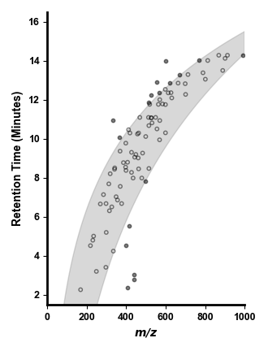
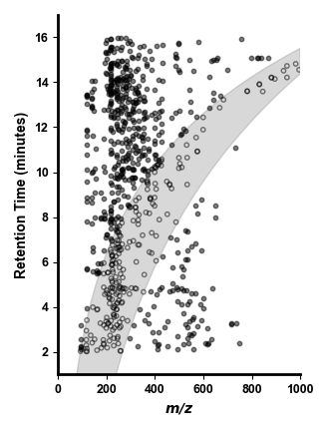
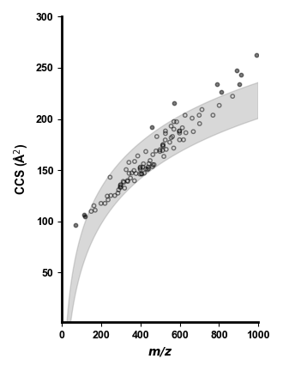
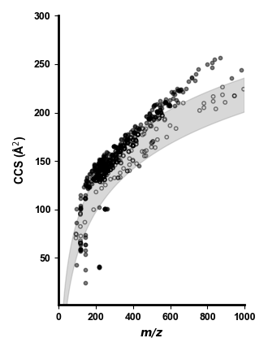


78 features
224 features
88 features
440 features
22 features
539 features
12 features
323 features
Point below cutoff
Point above cutoff

Slide 6
